Slide 1
TITLE : CAFÉ WITH ONLINE ORDERING (UI)
1
Café with Online Ordering: "Brew & Bean" café wants a site where users can build their coffee order. Use form elements (checkboxes for add-ons, number for quantity) and dynamically update the order summary and total price using HTML + CSS (conceptually, focus on the form UI).

Slide 2
INTRODUCTION :
This project is a simple café ordering webpage
Built using:
HTML → Structure
CSS → Styling
Font Awesome → Icons
No JavaScript is used

Slide 3
OBJECTIVES
To design a simple café website using HTML and CSS
To understand basic webpage structure and styling
To implement navigation without JavaScript using anchor links
To create a user-friendly interface for menu selection
To learn how to organize content using sections and layouts

Slide 4
HTML Structure :
The webpage is divided into sections:
  <header> → Title of café
  <nav> → Navigation menu
  <div> → Different pages (Home, Menu, Summary, Success)

Slide 5
Header Section :
  Displays café name
  Uses icon (coffee mug) from Font Awesome
  Styled with background color and text alignment
Navigation Bar :
Links are used to switch between sections
Uses anchor links (#home, #menu)
Styled as buttons using CSS

Slide 6
Menu Section :
Displays coffee options:
Espresso
Latte
Cappuccino
Uses:
Radio buttons → select one coffee
Checkboxes → select add-ons
Number input → quantity
Order Confirmation :
Users can:
Select coffee items
Choose add-ons
Enter quantity
Place order

Slide 7
IN FUTURE, ADD JAVASCRIPT TO:
Right now:
Coffee selection ❌ not stored
Total price ❌ not calculated
Summary ❌ fake/static
In future, add JavaScript to:
Detect selected coffee
Calculate total price
Show real data in Order Summary

Slide 8
CONCLUSION :
This project is a basic café website made using HTML and CSS. It shows layout design and page navigation without JavaScript. It is static, but can be improved in future by adding JavaScript, responsive design, and backend features to make it fully functional.

Slide 9
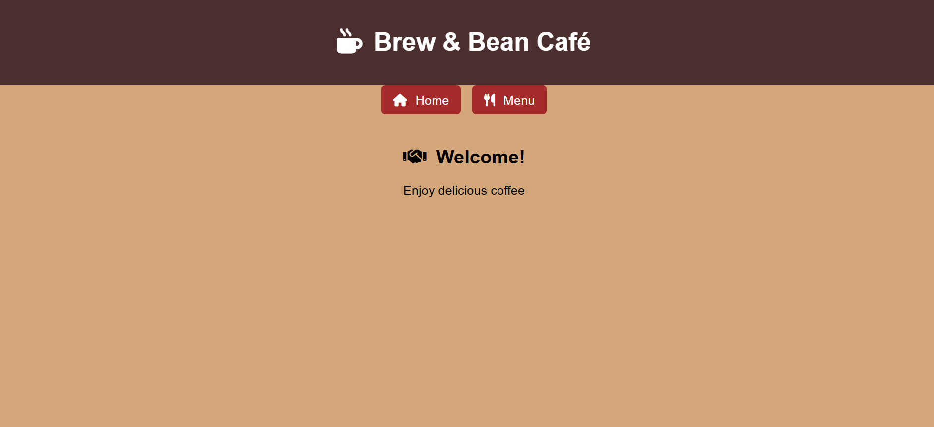
OUTPUT :
PAGE 1 :

Slide 10
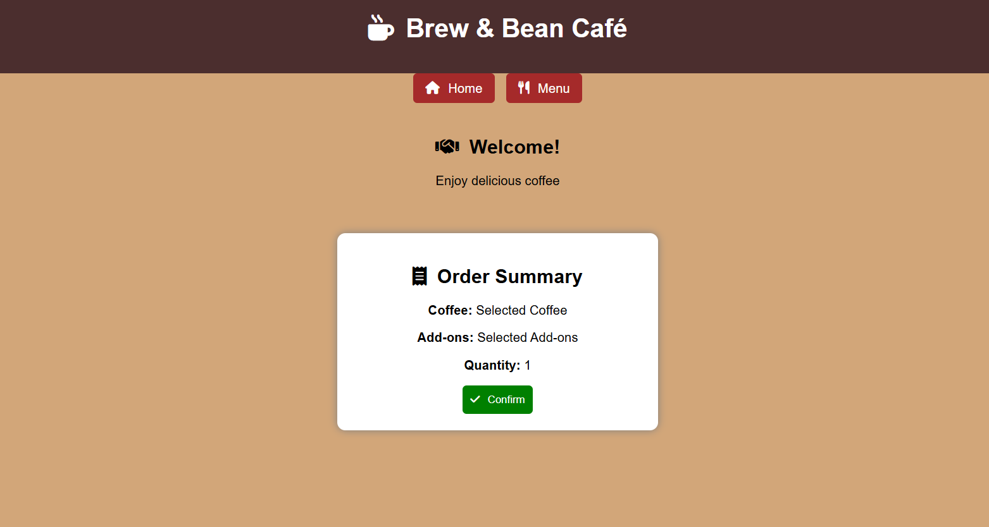
PAGE 3 :

Slide 11
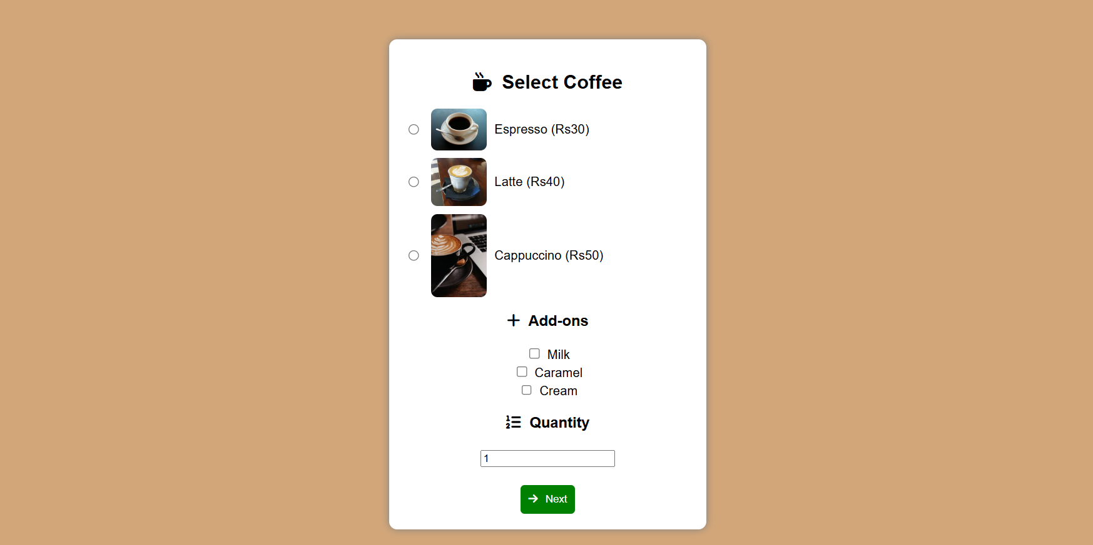
PAGE 2 :

